Slide 1
Anime Recommender
System
Team Member:
Zhao Zhang
Liu Bo

Slide 2
Objective & Background
Rise of eWorld: Youtube, Amazon,NetFlix
Popularity of Recommender System
Different types of recommender system:
Content-Based Filtering
Collaborative Filtering
Experiments of different recommender systems :
Anime Recommender System
Library Used:
sklearn, keras, pandas, matplotlib, numpy, seaborn, surprise, etc.

Slide 3
Anime Recommendation Database 2020
(Kaggle Datasets)
01.
02.
03.
anime.csv
anime_with_synopsis.csv
animelist.csv
04.
05.
rating_complete.csv
watching_status.csv
All anime information except synopsis(35 cols)
Basic anime information with synopsis(5 cols)
All user rating information with watching episodes and watching status( 5 cols)
The description of watching status (2 cols)
All users’ rating information whose watching status is completed ( 3 cols)
Notes:
There are totally 5 datasets of animation database, in which we used only three of them. Synopsis file contains the basic information of animations, maily for content-based filtering; Anime has all the information instead of synopsis; rating_complete contains all users’ rating information, and that rating is only valid and included in this file when the user has watched an anime completely (not want to watch or in watching, but watched).

Slide 4
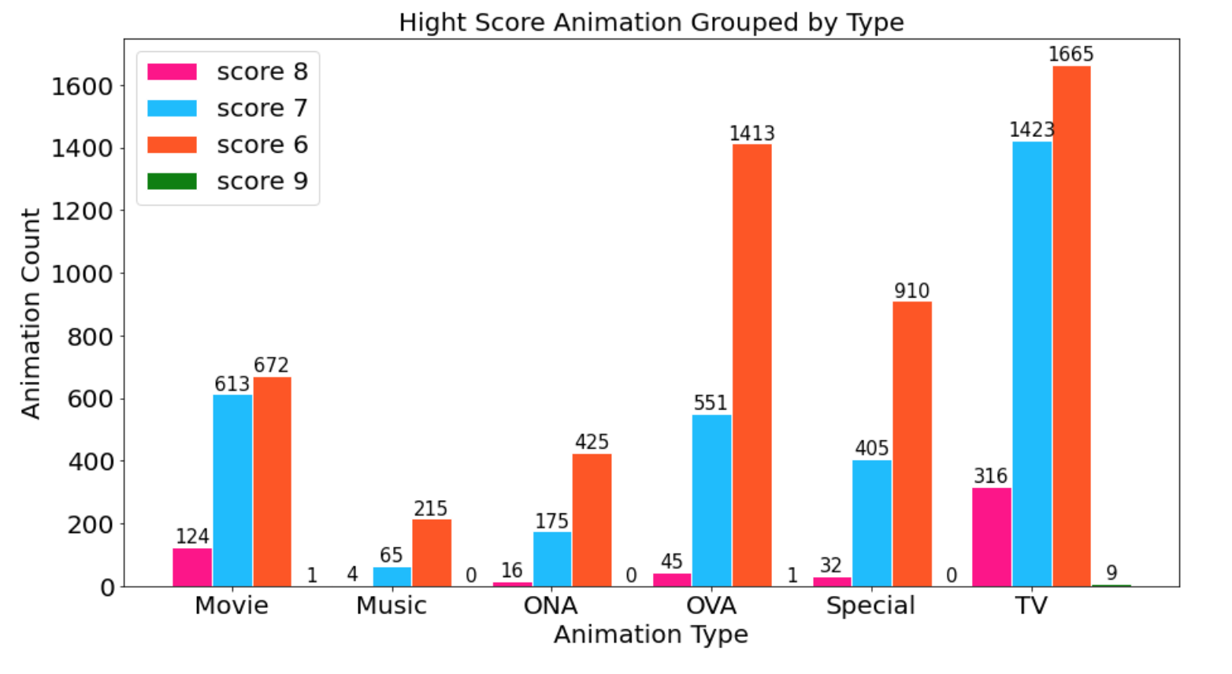
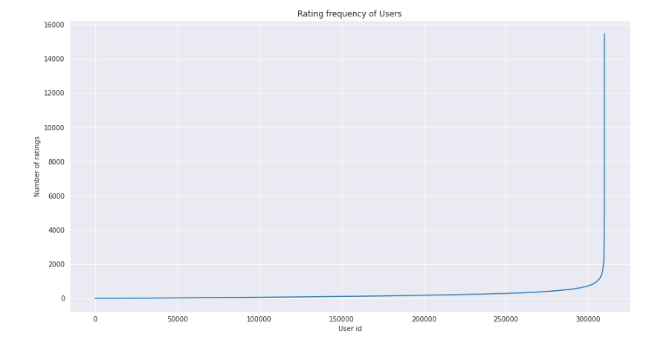
EDA & Preprocessing
Select key elements for further utilization, such as rating, core, anime type, etc.
Set min rating scores and numbers for user and anime, then filter out edge values
Drop abnormal values, such as Null
High-Score Animation Grouped by Type
Rating Frequency of User

Slide 5
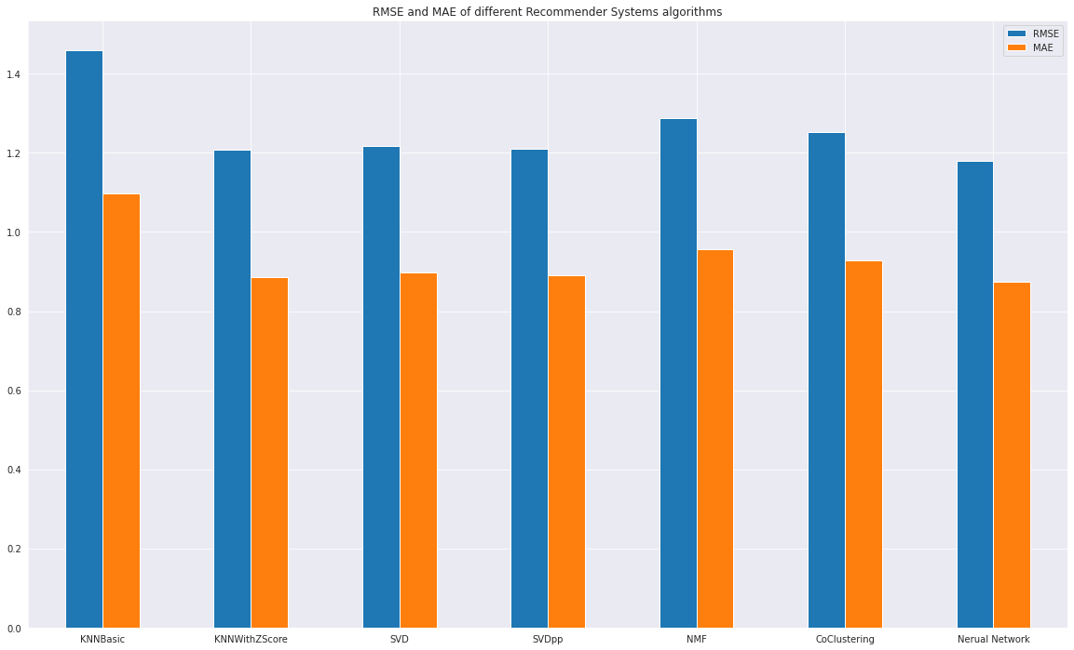
Main Task - Collaborative Filtering
Customized Version
KNN(scratch)
Solve Cold Boot
Surprise Library
6 Algorithms: , KNN Basic, KNNWithZScore, SVD, SVDpp, NMF, CoClustering
Tuning Hyperparameters
GridSearch with Cross Validation
Evaluation
RMSE and MAE
Visualization of Comparing 6 Surprise CF Algorithms & Neural Network
Notes:
We implement the recommender systems from two angels, one is writing from scratch, using our customized algorithm. Basically, it is a KNN that built two matrixs，user-item & item- item， then using cosine algorithm to calculate the similarity of animations they rated with high scores and other animations in the database，eventually sort the similarity and select top 10 as the final recommendation list.
The scratch version deal with cold boot when user is new or they merely rate animations，however， the space and time complexity are extremely high，which results in slow running of our system and hard to evaluate the whole database. Therefore， we changed our mind to another angel，that is utilizing the models in Surprise Library.

Slide 6
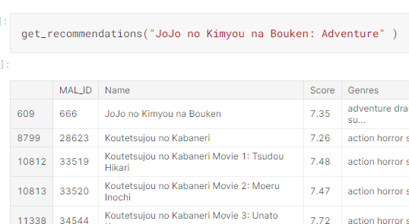
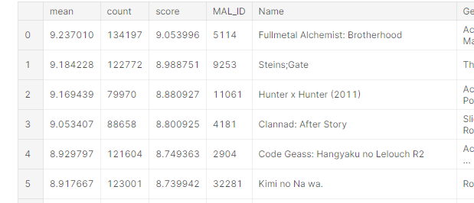
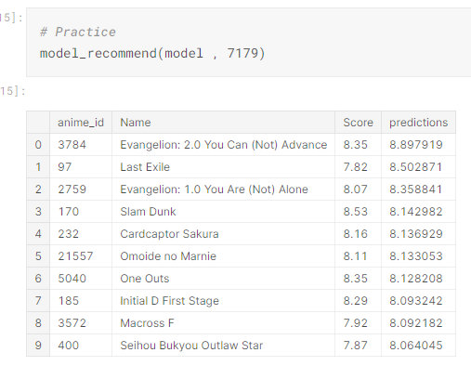
Subtask - Other Algorithms
Content Based
Weighted Rating
Neural Network
NLP method
(tf-idf and cosine similarities) find similar animes with similar genres and synopsis
Ranking all anime based on new formula including number of votes and average rating
Concat User embedding and Anime Embedding

Slide 7
Thank You for Listening!

